Slide 1
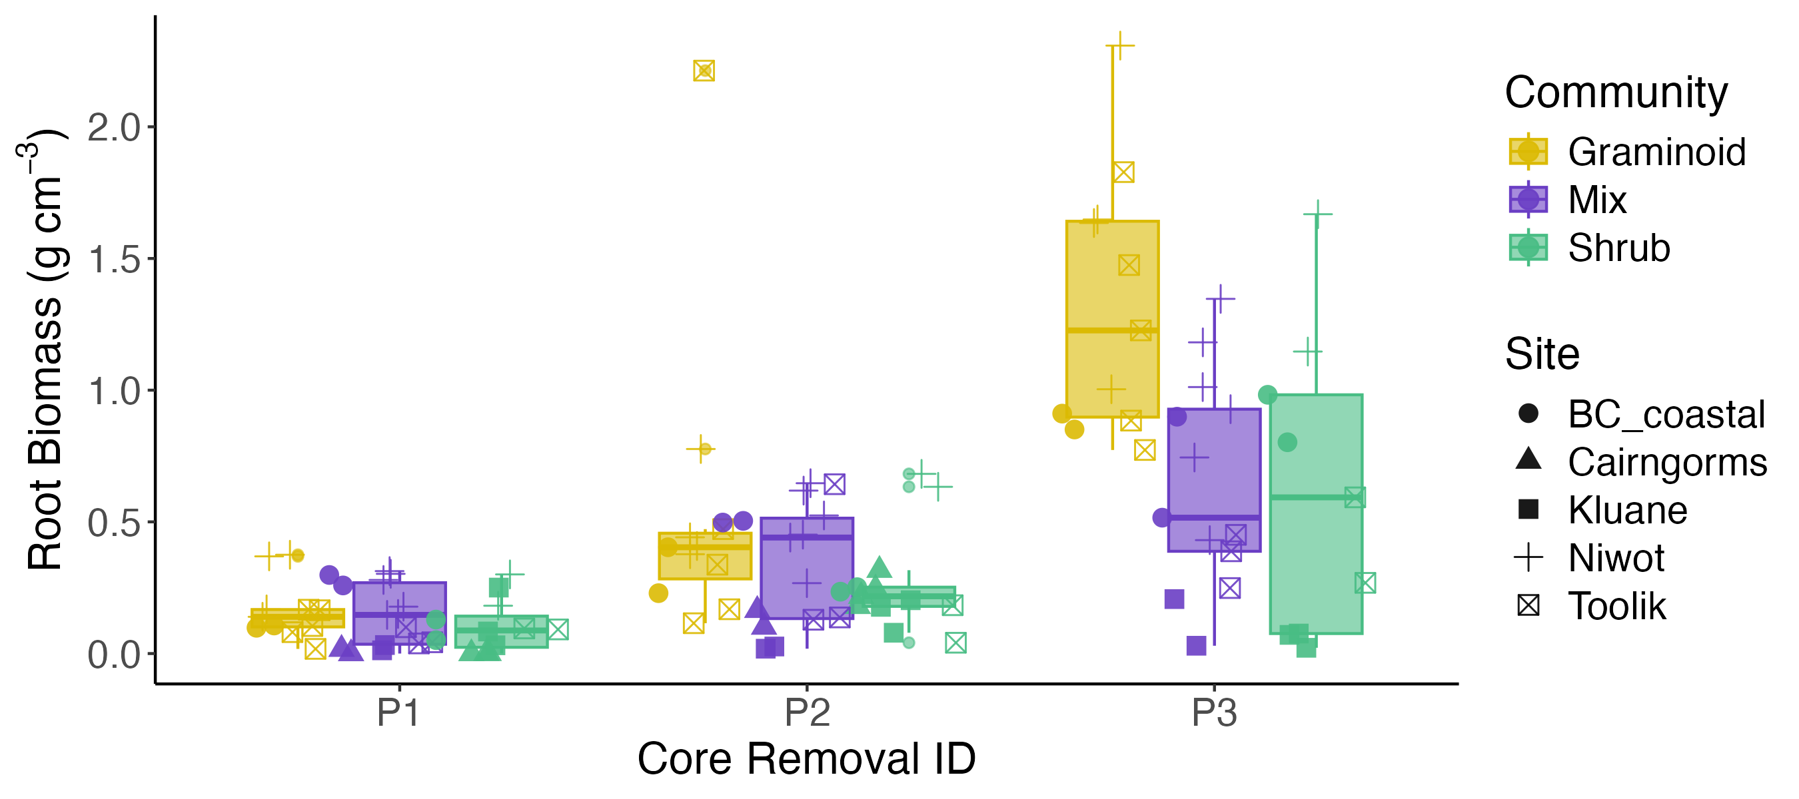
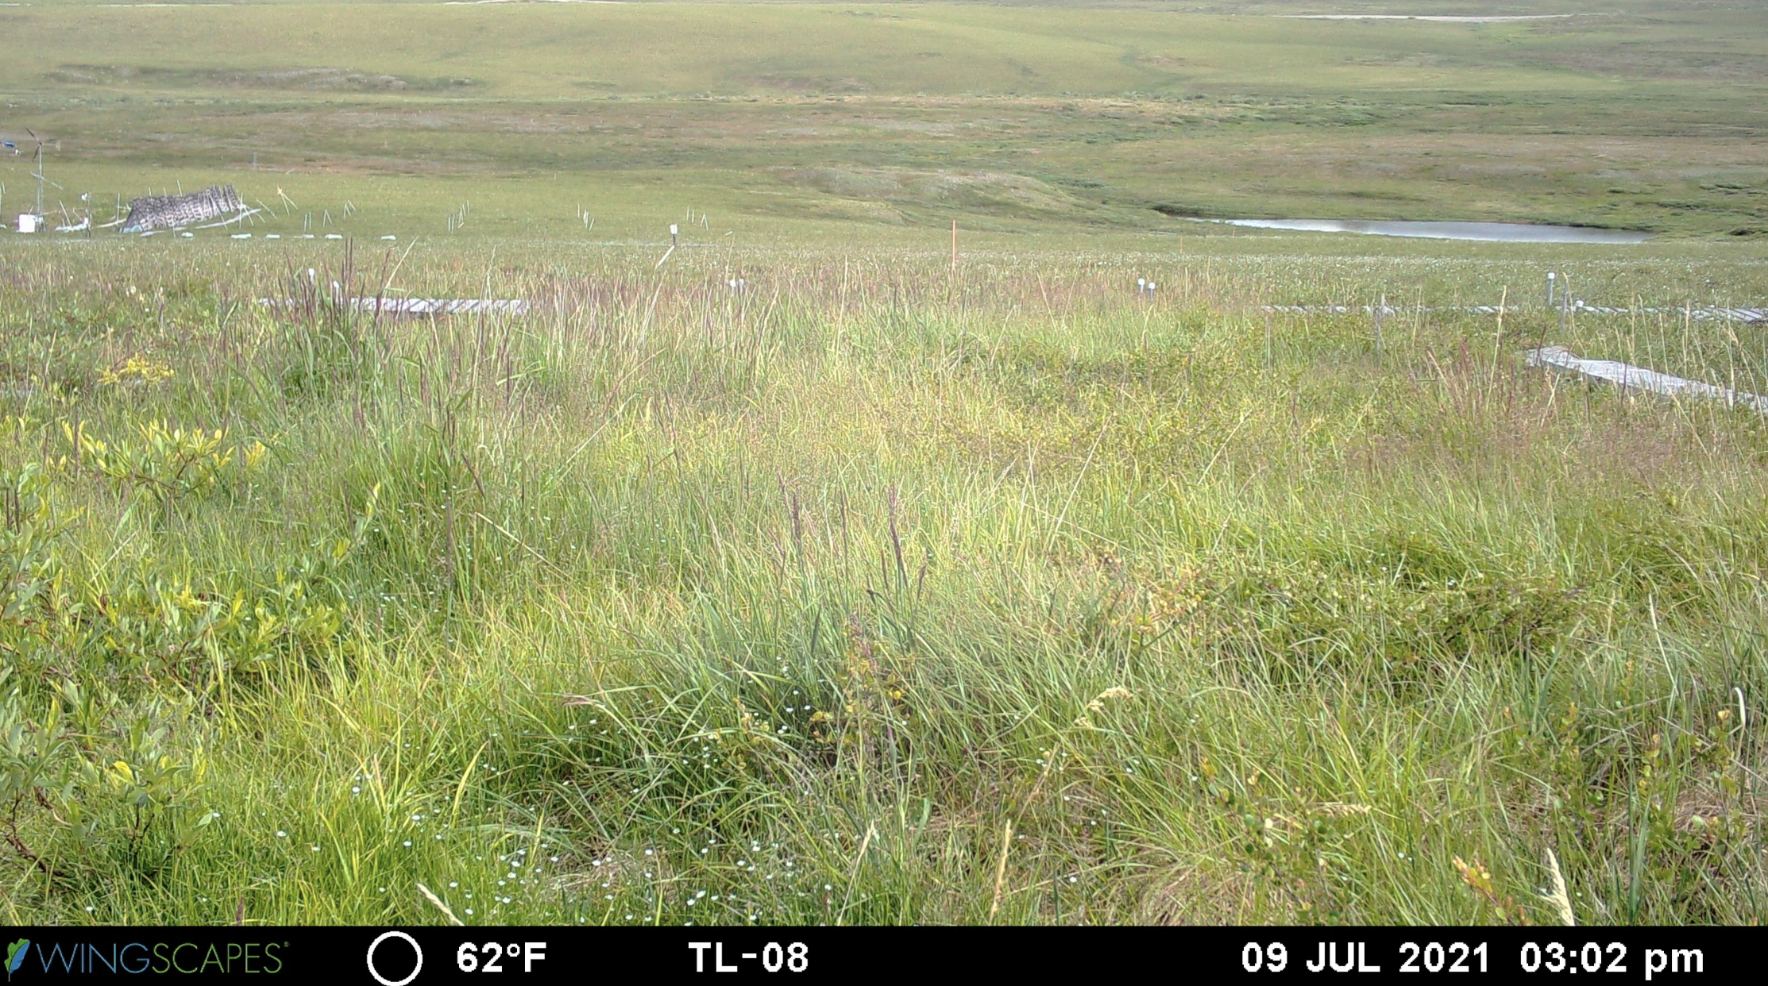
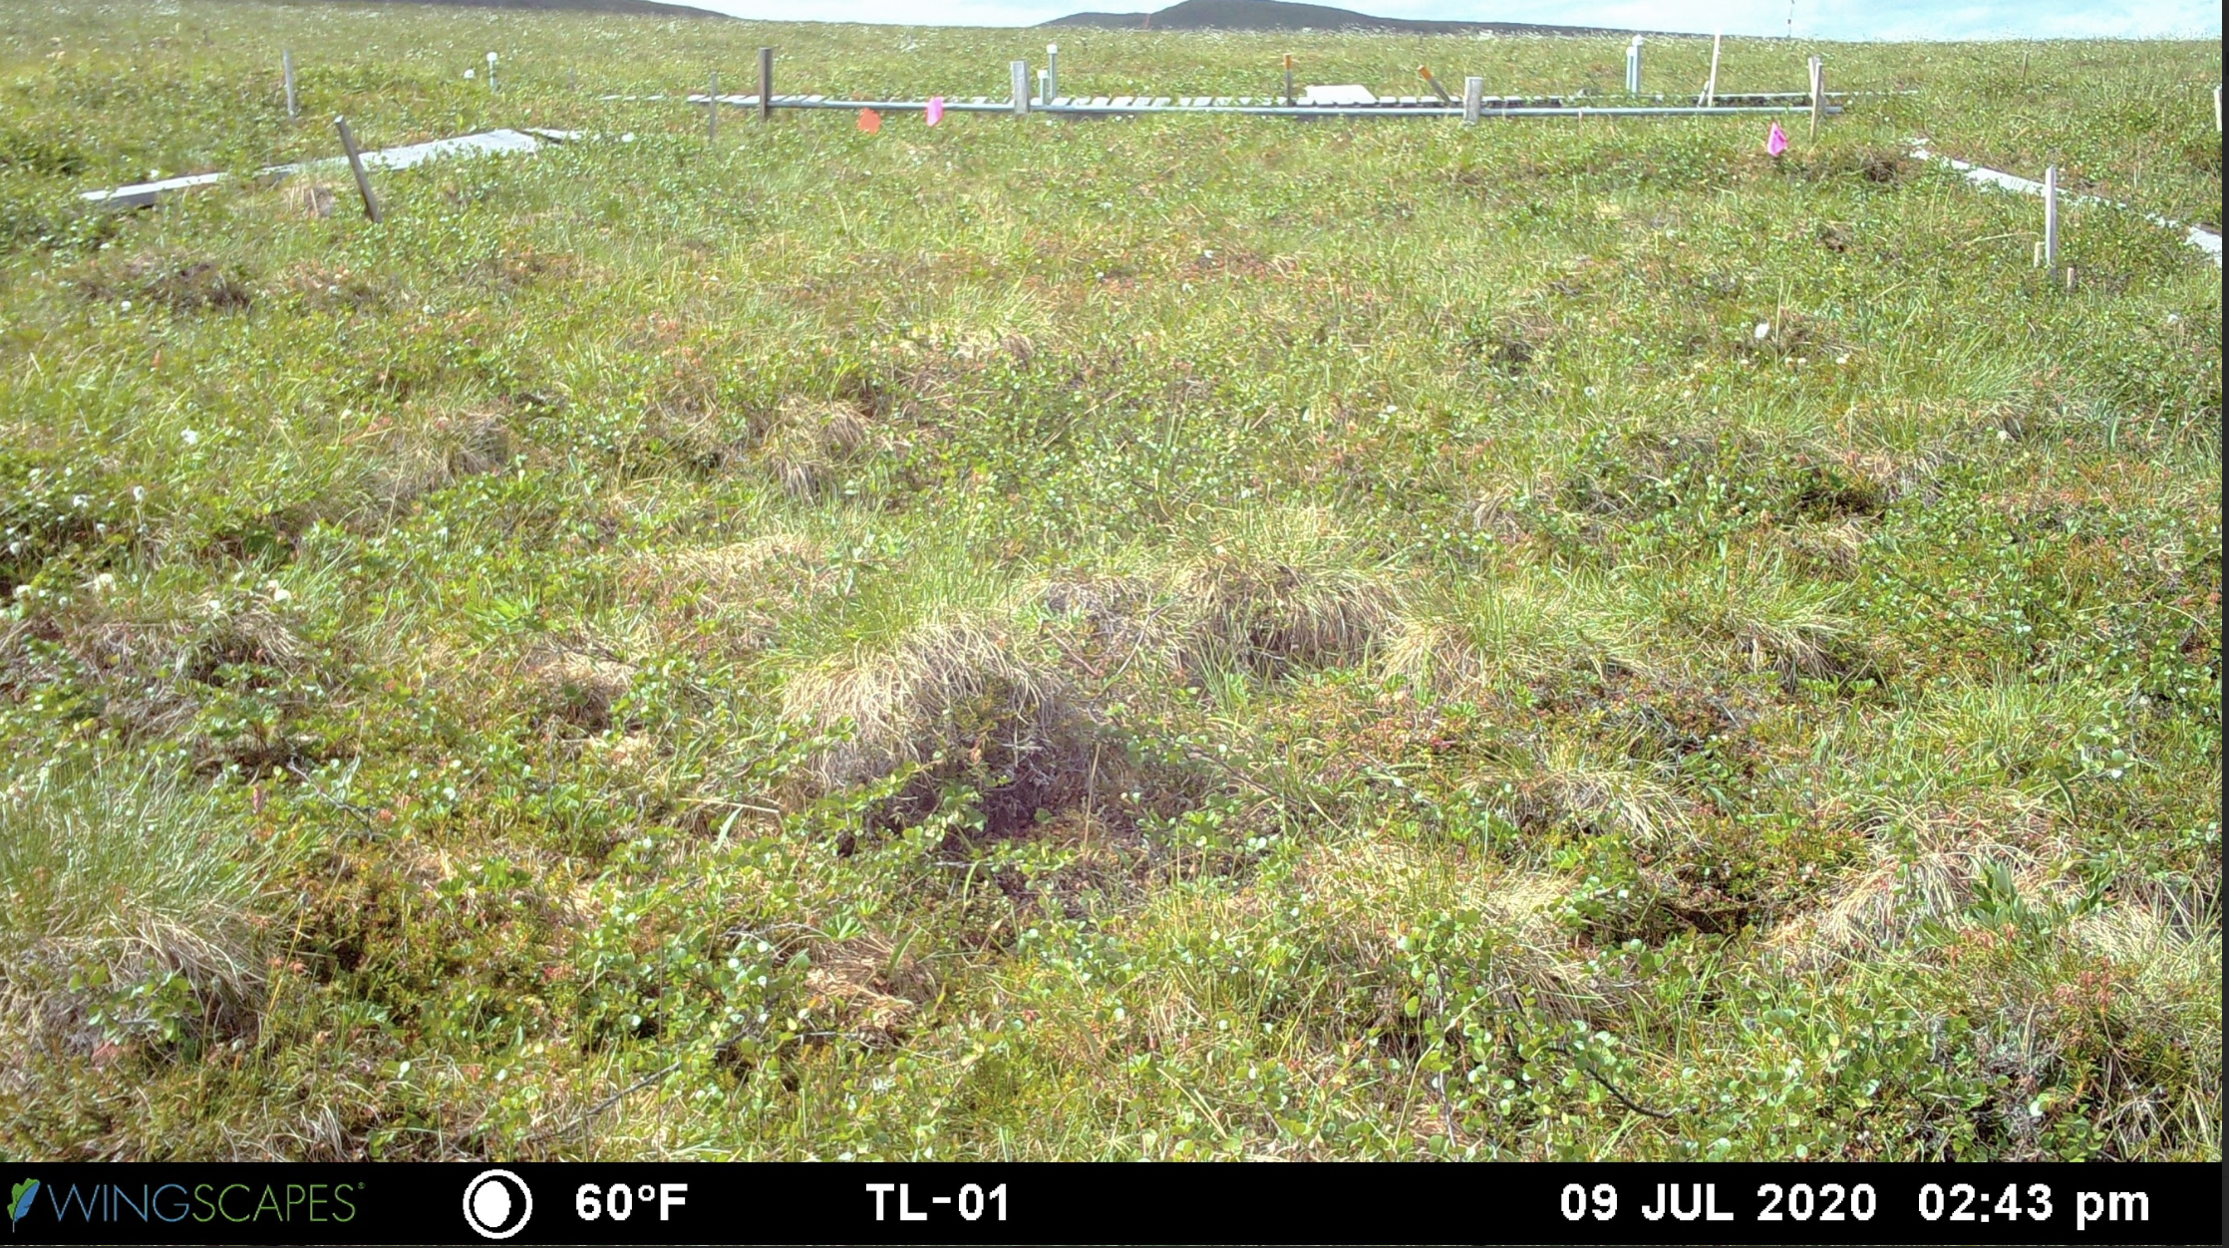
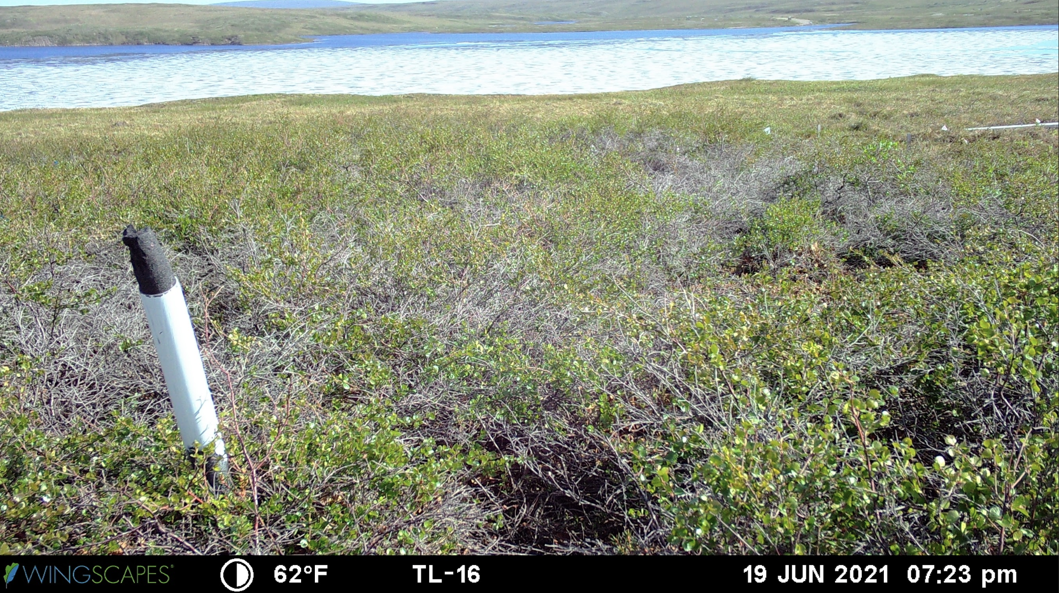
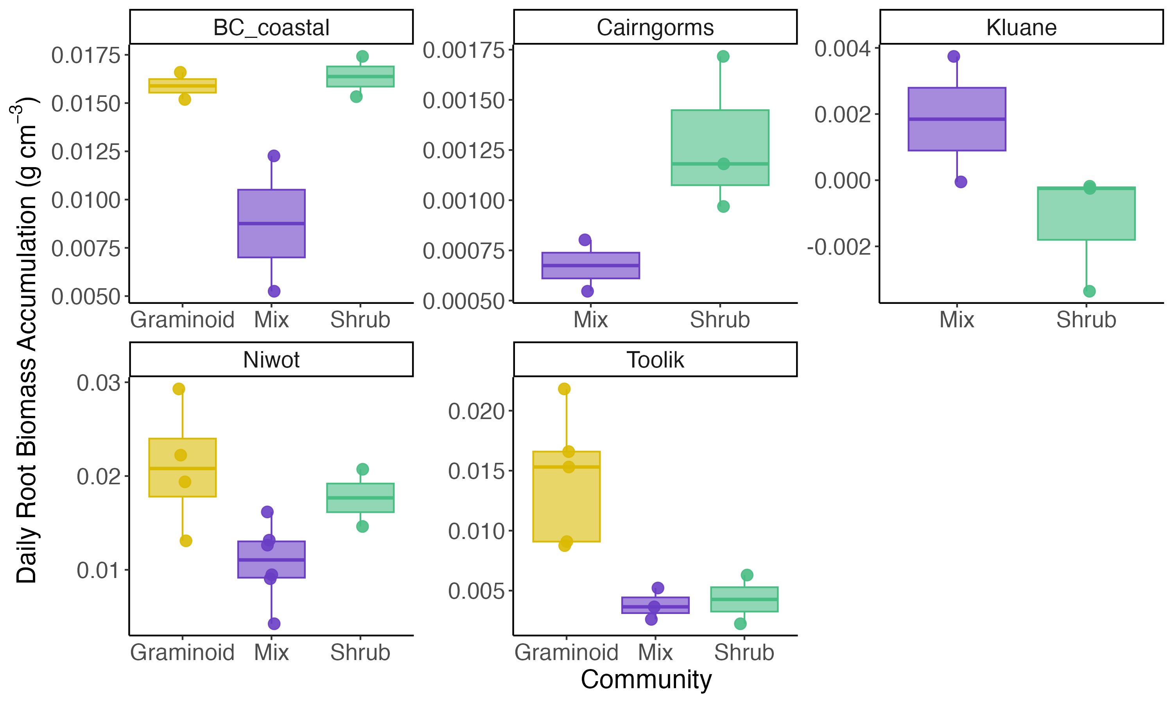
a)
Diff: 0.88
(0.73 to 1.07)
Diff: 0.2
(0.04 to 0.4)
Diff: - 0.01
(-0.22 to 0.22)
Diff: - 0.04
(-0.23 to 0.18)
b)
Diff: - 0.01
(-0.01 to -0.00)
Diff: - 0.01
(-0.01 to -0.00)

Slide 2
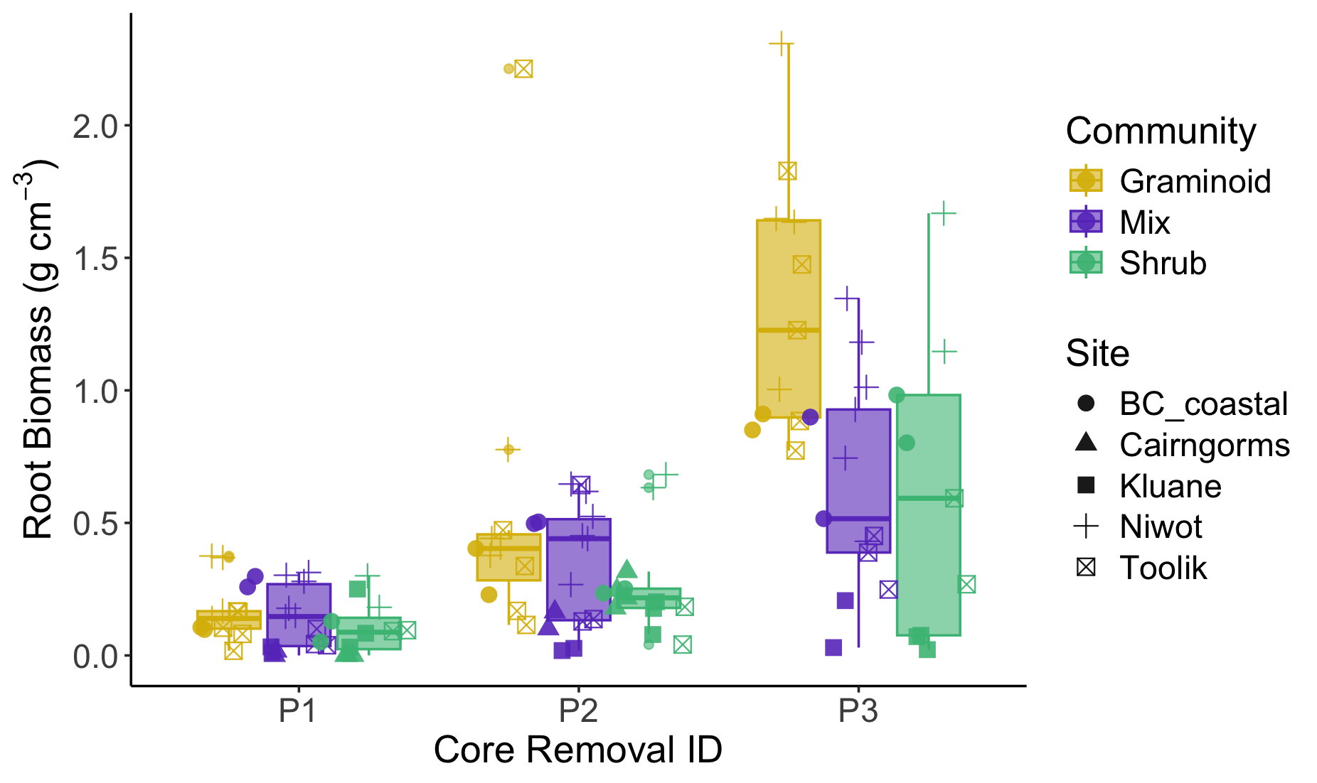
a)
Diff: 0.51
(0.42 to 0.60)
Diff: 0.24
(0.15 to 0.32)
b)
Diff: - 0.01
(-0.01 to -0.00)
Diff: - 0.01
(-0.01 to -0.00)

